Slide 1
AIAA Next Gen Symposium
Hidden Issues and Limitations of Machine Learning
Bias, Opacity, Dependencies, and More!
Benjamin Etheredge
Notes:
Intro.
Ask audiance experience
Thank AIAA
Not going to talk much about mitigation. I didnt think there would be enough time in the 20 min speech window
Other guy talked about some of these, but may have overhyped me a bit

Slide 2
Benjamin Etheredge
AI/ML Enthusiast
AI/ML Software Engineer
Modern Technology Solutions, Inc (MTSI)
Notes:
This is me.
I didn’t want to put my picture up there because… well I don’t really have a good reason.
I consider myself an AI/ML Enthusiast first. But now that AI/ML is in my job title, i should probably call myself something else

Slide 3
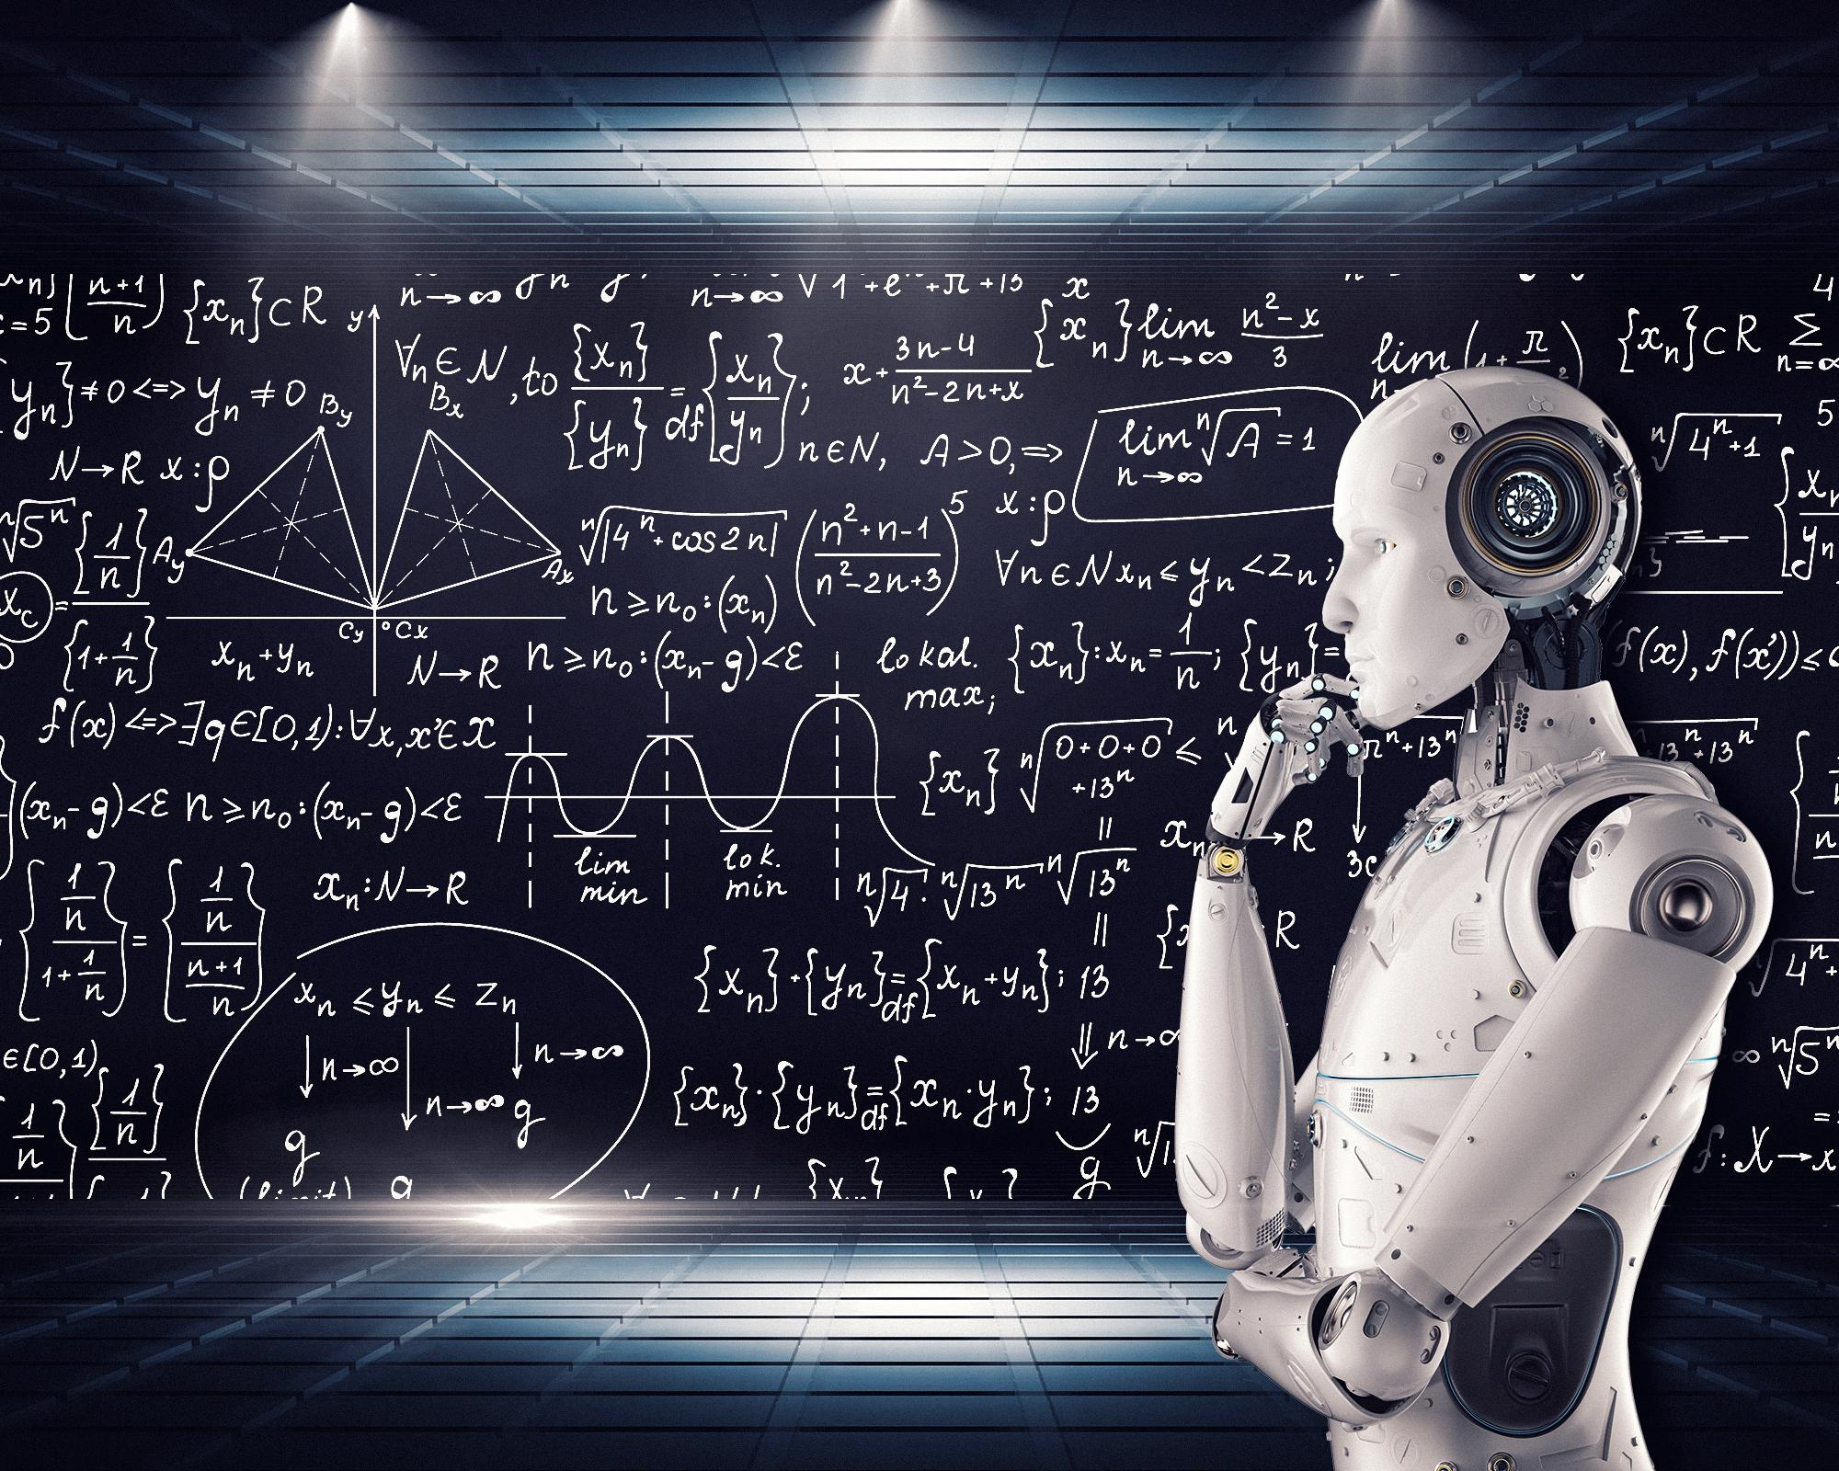
Disclaimer: I love AI/ML
Mike MacKenzie | Image via www.vpnsrus.com
Notes:
Before we get started, quick disclaimer.
I love AI. It’s where I want my career to be.
But that doesn’t mean I’ll let that love blind me to what AI/ML really is underneath all the surrounding hype of it

Slide 4
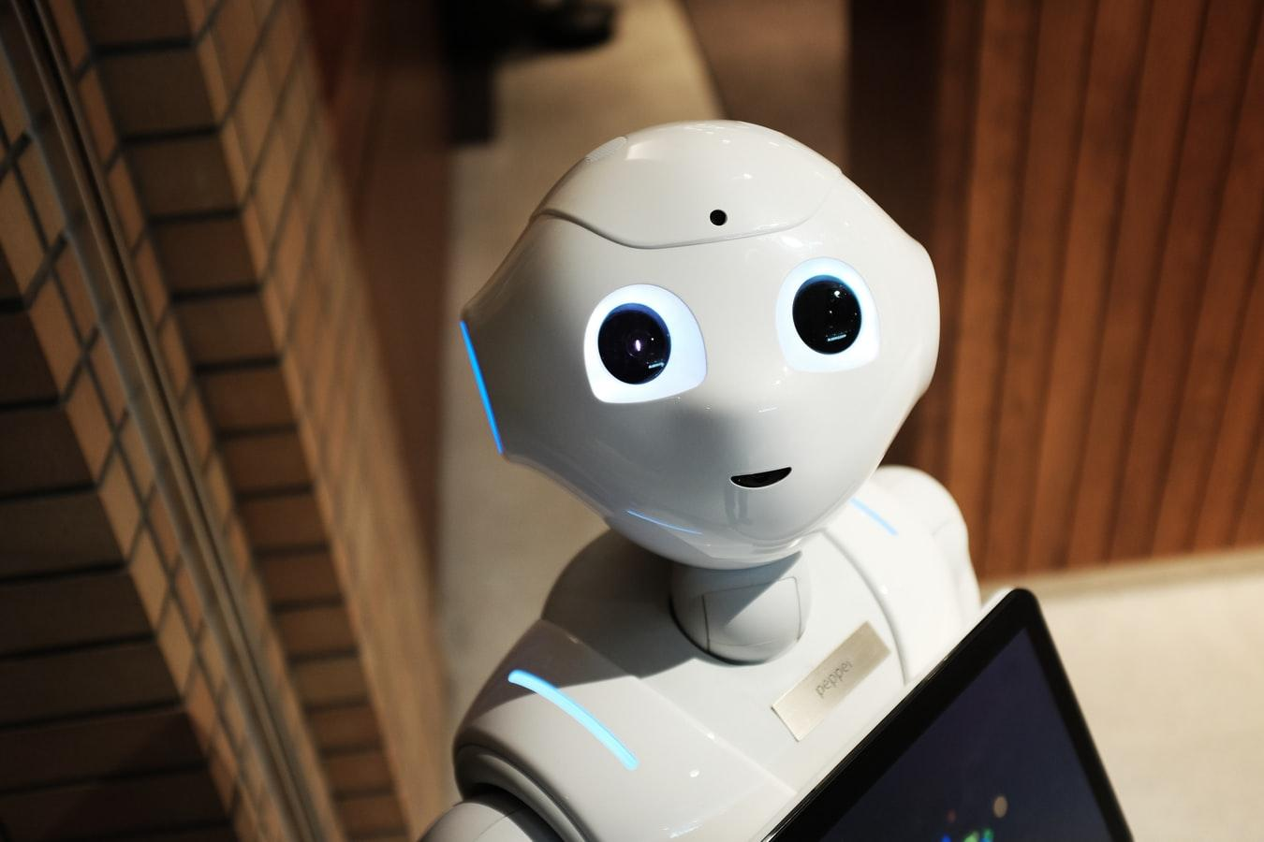
Brief Intro to AI & ML
“... AI is all about figuring out what to do when you don’t know what to do.“ -Peter Norvig
https://images.unsplash.com/photo-1485827404703-89b55fcc595e?ixlib=rb-1.2.1&ixid=eyJhcHBfaWQiOjEyMDd9&auto=format&fit=crop&w=1350&q=80
Notes:
So let’s briefly hit on some general AI information to give some context and perspective.
This Peter Norvig quote is my favorite description on AI.
There are SOOOOOO many different definitions of AI. Consensus on AI terminology is definitely not perfect.
Add quote about ai becoming algorithms if solved

Slide 5
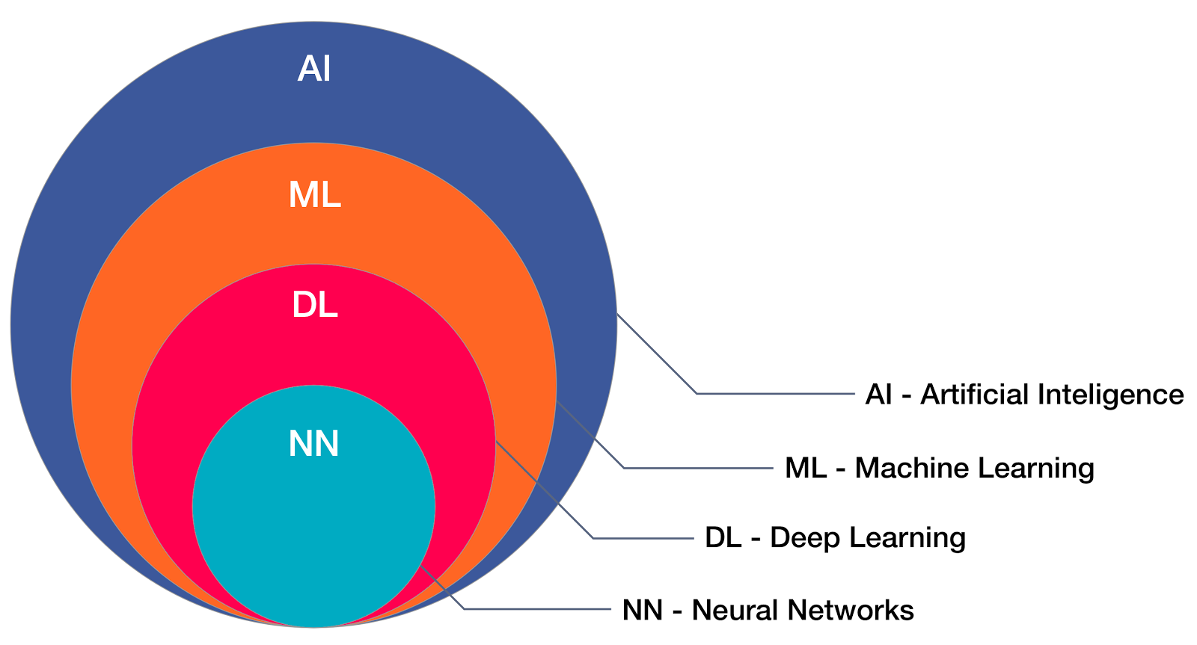
Relationships
https://www.aimlmarketplace.com/images/Startup-images-1/difference-between-ai-ml-dl.png
Notes:
Here’s how things stack up
ML is just one part of AI
DL is just one part of ML
This should give some perspective to where topics fall in the taxonomy

Slide 6
Levels of AI
Technology is here
Artificial Narrow Intelligence (ANI)
“Weak” AI
“Applied” AI
One Task
Artificial General Intelligence (AGI)
“Strong” AI
“Full” AI
Multiple Tasks
Artificial Super Intelligence (ASI)
Super Human
We want to go here
Hollywood is here
Notes:
ANI is where AI currently is and has been for a while
All the recent eye popping breakthroughs of the past few years has still been in ANI.
AGI is where we want to go
That is the “holy grail” of AI research.
That is the big push
And if you’ve seen any movie featuring AI, chances are, this is the category it was in
This is the level beyond human capabilities
As you can see, we’re not even close yet
See if i can find how much money is being thrown at it AGI

Slide 7
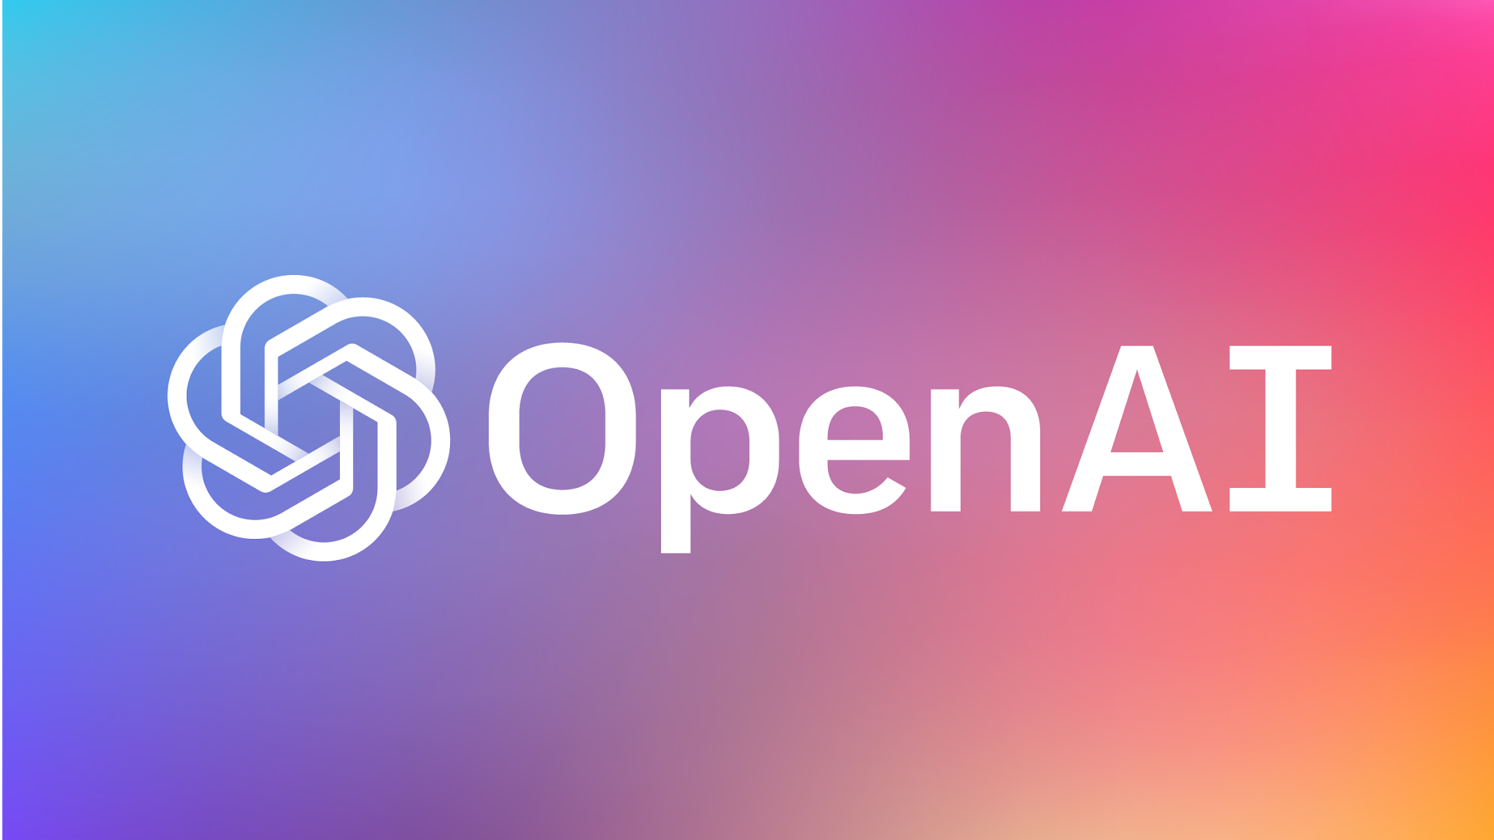
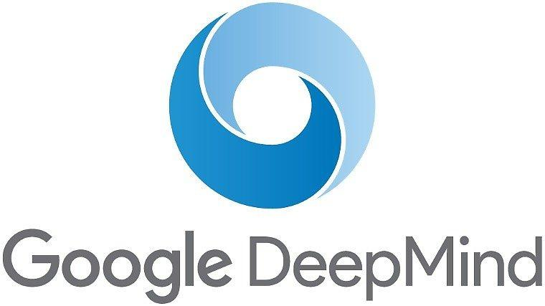

Reaching the next level of Artificial General Intelligence
Reinforcement Learning
By Megajuice - Own work, CC0, https://commons.wikimedia.org/w/index.php?curid=57895741
Notes:
Multiple companies are working hard on reaching AGI
Specifically OpenAI, they were literally founded to pursue AGI and pursue it ethically/safely
Maybe the path there is through RL (that’s what I think and OpenAI seems to as well)

Slide 8
Getting to ML Specifically
Notes:
So turning our focus to ML now
Let’s get to the bottom of it

Slide 9
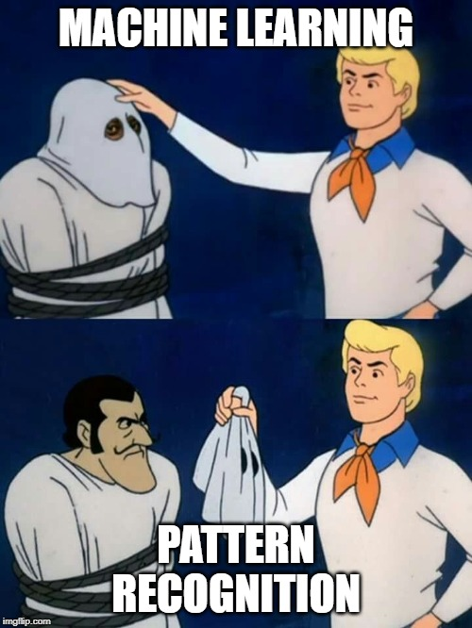
Benjamin Etheredge | Meme Generator
Notes:
Under the hood, ML is just pattern recognition
It’s looking for patterns in features of data
That’s not to say pattern recognition is not powerful. It has shown is usefulness in performing tasks we find hard to describe like image recognition or walking.
This change is what’s pushing AI right now past the limits of expert systems requiring specific instructions on how to solve a task.

Slide 10
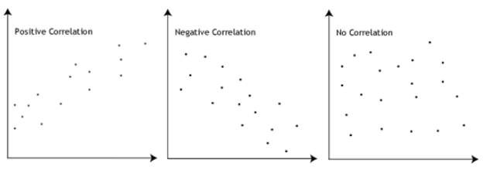
It’s All Correlation

Slide 11

Correlation Does NOT imply Causation
https://xkcd.com/552/
Notes:
Correlation does NOT imply causation
ML models make predictions off correlations. Not causations
AI struggles deeply with learning causations. Learning causations is a VERY difficult task

Slide 12
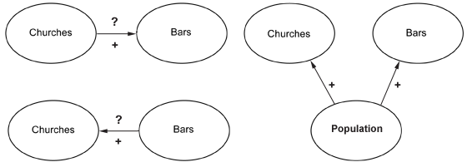
Causal Reasoning
http://www.txprofdev.org/apps/ct/accessible.php?asset=34&tags=18
Notes:
Causal Reasoning is what AI (and of course by extension ML) currently is not so good at
ML models and can learn the correlations to make their predictions, but they can’t learn the underlying cause
Example, the number of bars in a town has a positive correlation with the number of churches.
So does this mean churches causes bars? *Probably* not.
There is another feature that is causing both.
But even if you presented an ML model with all three features, it would only be able to determine that they all three correlate
Determining causation requires intervention and counterfactuals

Slide 13
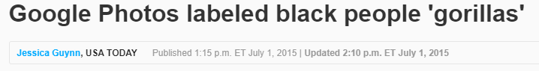
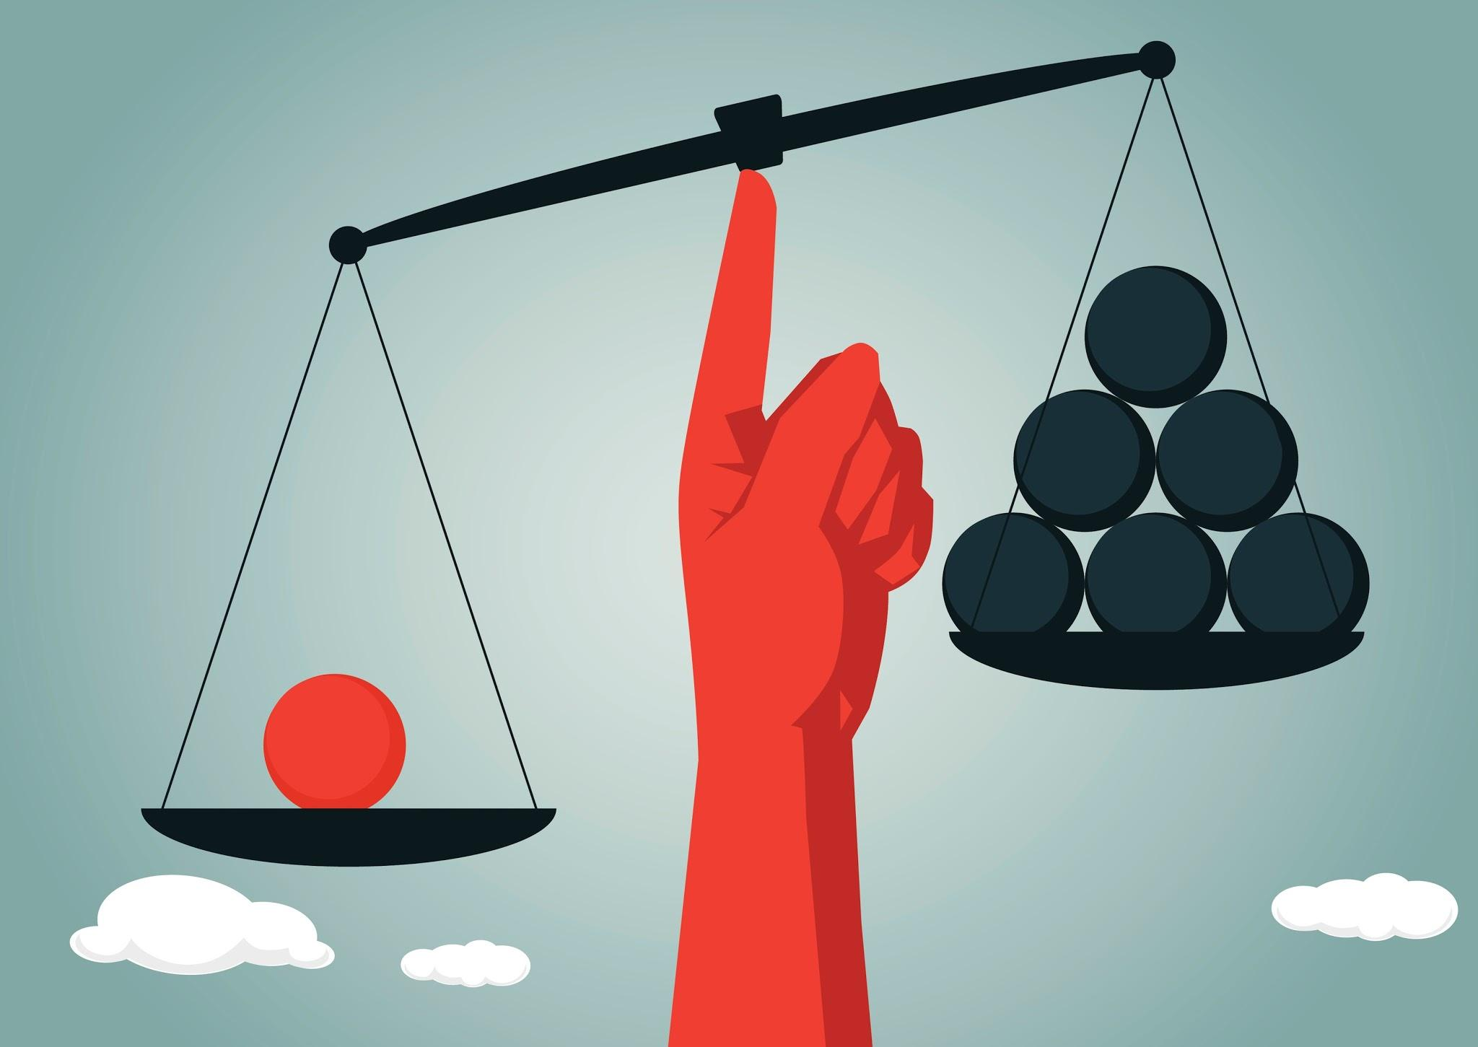
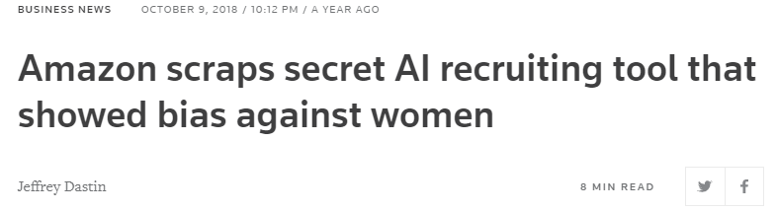
Bias in Models
Notes:
Bias can creep in
Mostly from data
At Google trained their data on mostly white faces, thus it didn’t work well on other ethnicities
At amazon, most applicaants and employees were male, thus the algorithms weighted female applicants negativly. It would negatively weight resume wording that indicated female gender (women’s chess team, women’s schoold, etc.)
Data is bias because we are bias
Garbage in garbage out
One of the best ways to counteract bias in models is looking inside the model and determining why the model made certain decisions…. But….

Slide 14
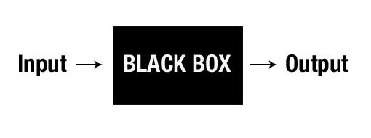
Interpretability
https://www.kdnuggets.com/wp-content/uploads/blackbox.jpg
Notes:
Most ML methods are practically black boxes to us.
We through things into and it spits out its answer
This may be okay for some applications, but it most certainly isn’t for others
An example of this is banking. Banks can’t use black box ML methods for loan approval because they are bound by law to say why they didn’t approve a loan.
Simply pointing to a model is not good enough.
Add note about how a lot of training is but in making the black box work

Slide 15
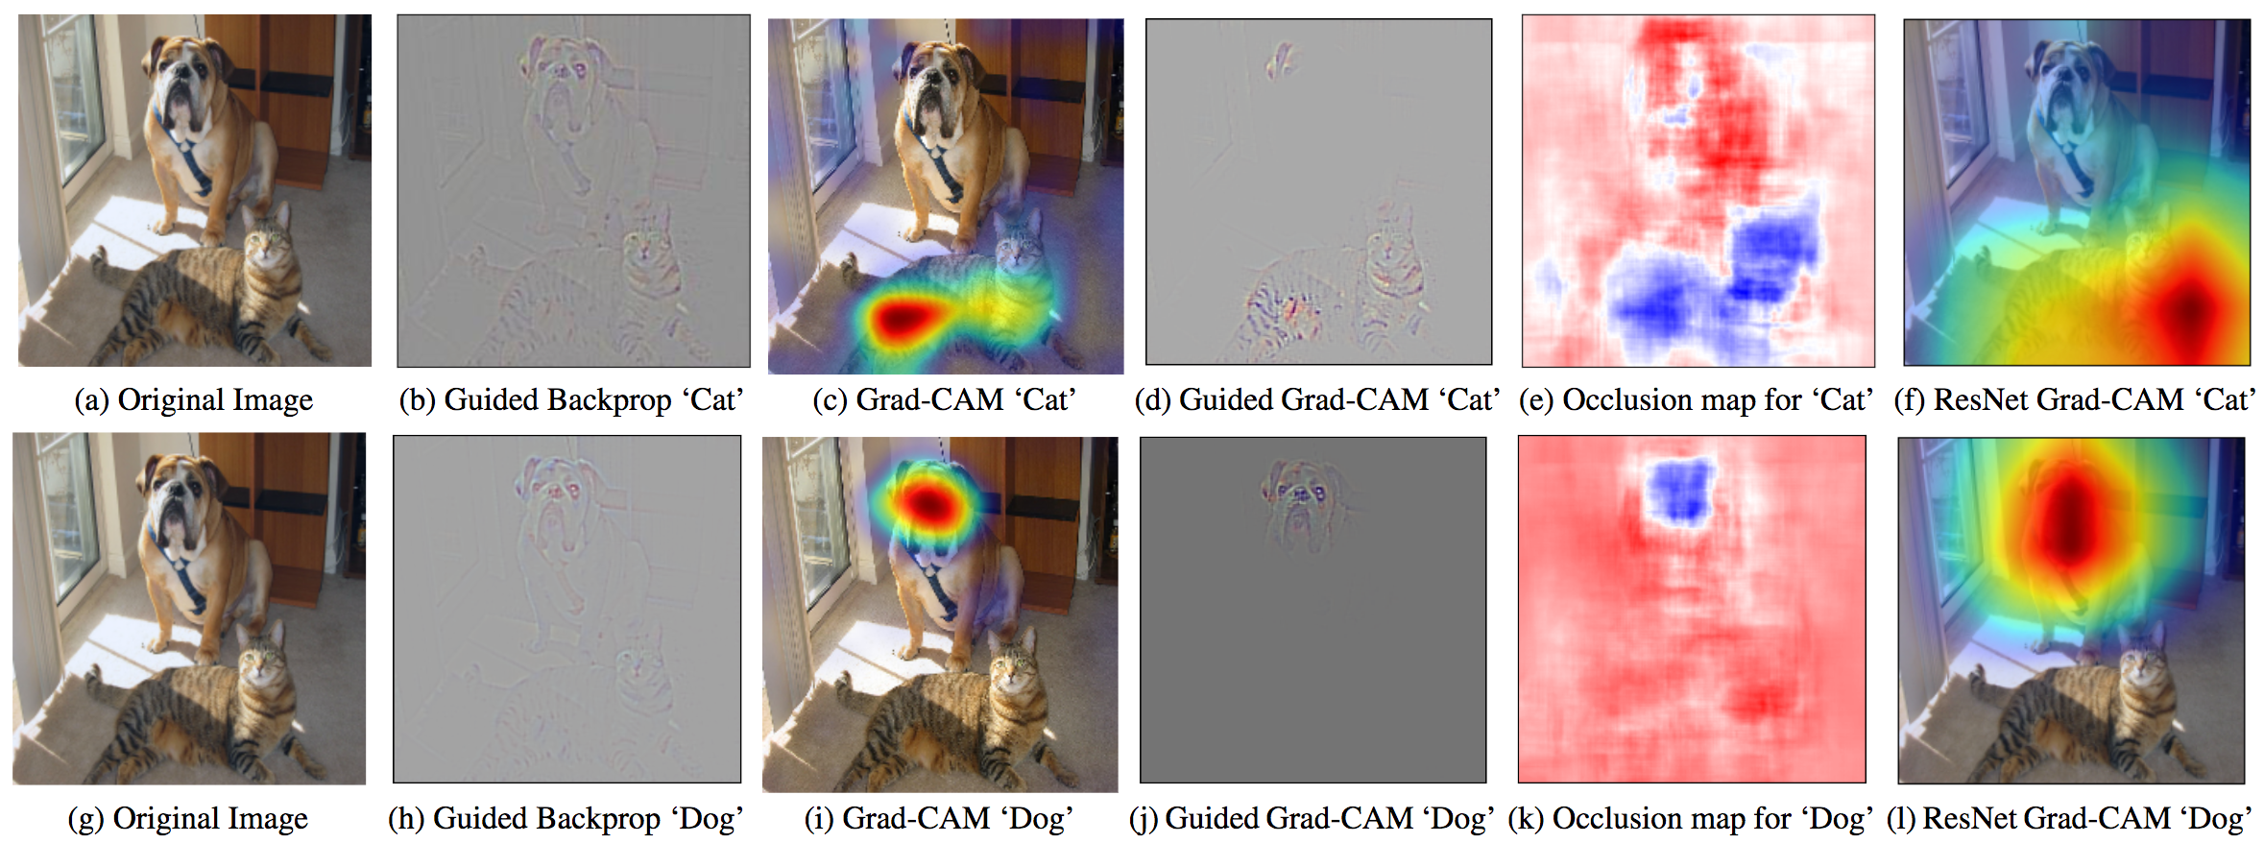
Interpretability
http://www.shallowmind.co/jekyll/pixyll/2017/12/30/tree-regularization/
Notes:
That’s not to say there isn’t some things we can do to get some insight into why models made decisions, but it doesn’t completely alleviate the opacity issues

Slide 16
Not Invulnerable:
Security Issues
Notes:
Believe it not, ML models are not invulnerable or impervious to attacks.
ML has been rapidly developed in research environments without security as a primary concern.

Slide 17

Adversarial Example
https://openai.com/blog/adversarial-example-research/
Notes:
This is one of the famous demonstrations of adversarial examples
Through some fancy work through accessing the models weights (or just the models inputs & outputs), strategic noise can be created to fool the network
See how the image doesn’t appear to have changed to our eyes, but he model is saying it’s something vastly different.
This isn’t just a synthetic problem
*add talk about how it is commont of models trainined on the same trianing data

Slide 18
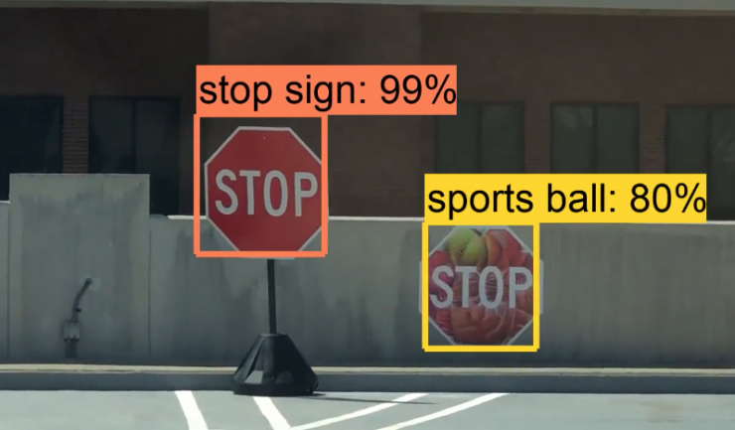
Adversarial Example
https://www.cc.gatech.edu/news/611783/erasing-stop-signs-shapeshifter-shows-self-driving-cars-can-still-be-manipulated
Notes:
It can be done in the real word too
As a person close to military software, this is a legit concern. Adversaries will target our networks
Another common example is using stickers to achieve the same results. A team in China claims to be able to cause Tesla’s autopilot to change lanes into oncoming traffic with a sticker

Slide 19


Some Other Vulnerabilities
Poisoning Attacks
Training Data Leakage
Microsoft Tay (bot)
Notes:
Does anyone remember tay? From every day 19 year-old to nazi in <24 hours. Training data poisoning
If you can inject data into what’s used to train to model, you can bend its performance to your will
The information in training data can sometimes be recovered from a trained model.
So Personally identifiable information could be recovered from models that are deployed

Slide 20
Deploying Models and Keeping Them Deployed

Slide 21
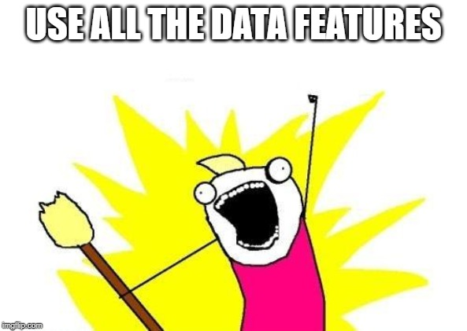
Data Dependency
Benjamin Etheredge | Meme Man
Notes:
ML models depend on the features
What features should our models use?
We want to grab all the features to get the highest possible score (we greedy)
This injects a ton of data dependicy. What happens if any of those features change?
Another example, it’s all too easy to start using the outputs of other systems in our models. Of course, use the information from another system? So what happens when those outputs change? (hint our model breaks or degrades)

Slide 22

Concept Drift
https://www.flickr.com/photos/viucsr/4348115392/
Notes:
Concept drift - wikipedia - “In predictive analytics and machine learning, the concept drift means that the statistical properties of the target variable, which the model is trying to predict, change over time in unforeseen ways. This causes problems because the predictions become less accurate as time passes.”
Real world is always changing
The correlations our model uses will change
Our model will degrade in performance while deployed
The maintance phase of ML model software development is much larger than people think.
You can’t just move your ML engineers away after the model is deployed
Entropy like thermodynamic

Slide 23

Ending Disclaimer:
Hotbeds of Research
Notes:
Just wanted to say that all the things I have mentioned are extremely hot topics in AI research right now
People are working hard to solve them, and I hope to become one of those people
But information on how much money is being thrown on it
How many papers are published
PhDs

Slide 24
End.
Questions?
Hidden Issues and Limitations of Machine Learning
Bias, Opacity, Dependencies, and More!
Benjamin Etheredge
Benjamin.Etheredge+AIAA@gmail.com
AI/ML Software Engineer
MTSI
Notes:
That’s it.

